Slide 1

Resume Classification Project
Team: Group2
Tejashri Deshmukh
Nazeera M
Simran Shaikh
Subash S
Rajesh Chary
Rahul Gilorkar
Mentor Name:
28th June 2022

Slide 2
Business Problem:
The document classification solution should significantly reduce the manual human effort in the HRM. It should achieve a higher level of accuracy and automation with minimal human intervention.
The dataset is having skills and categories.

Slide 3
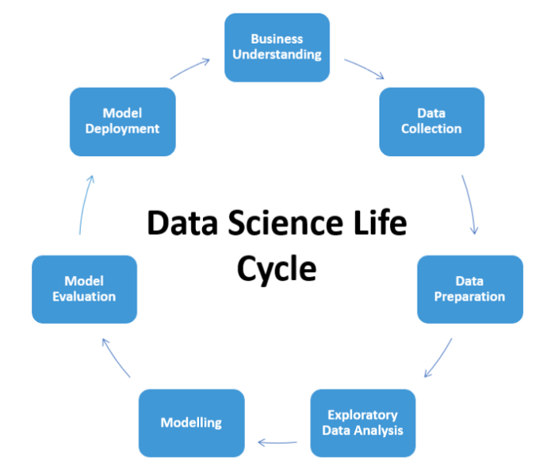
Project Architecture / Project Flow

Slide 4
Exploratory Data Analysis (EDA) and
Feature Engineering.

Slide 5
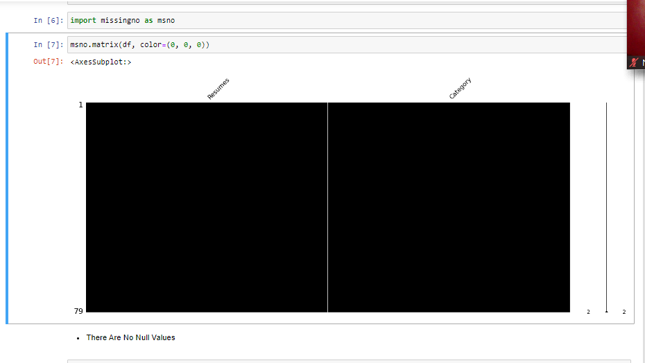
DATA SET DETAILS
Handling Missing Values and Duplicates

Slide 6
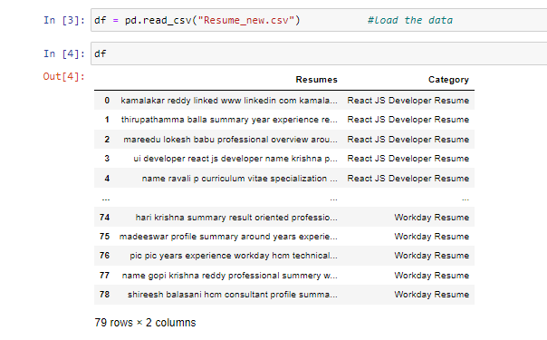
DATA SET DETAILS

Slide 7
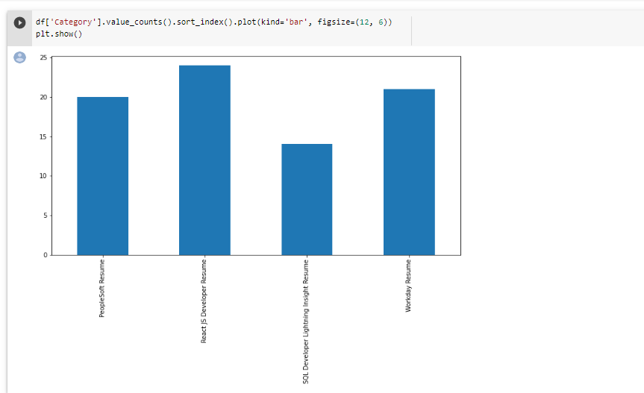
DISPLAYING THE CATEGORIES
Displaying the distinct categories of resume and the number of records belonging to each category:

Slide 8
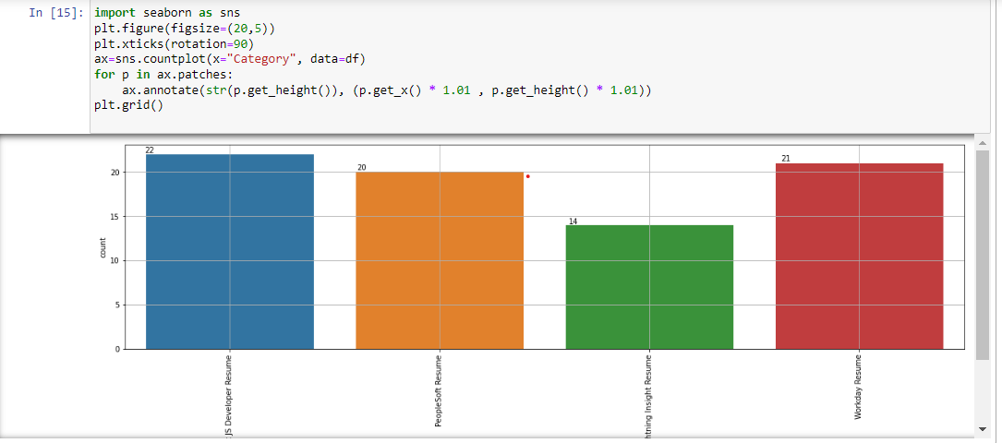
Visualization
Visualization of various categories

Slide 9
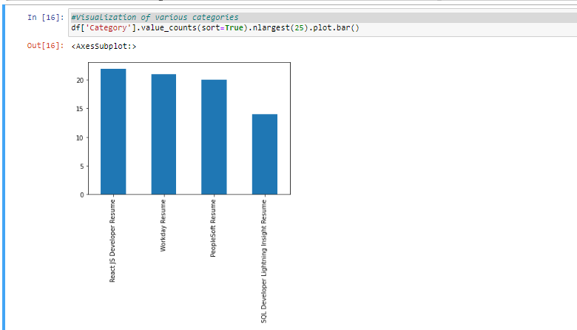
Visualization
Visualization of various categories

Slide 10
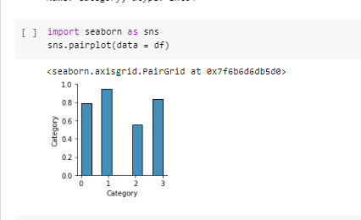
Visualization
Visualization of various categories

Slide 11
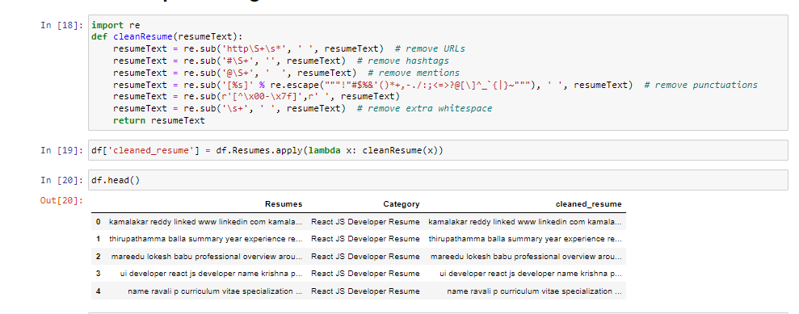
Text Processing
We have removed tags and converted all data into smaller.

Slide 12
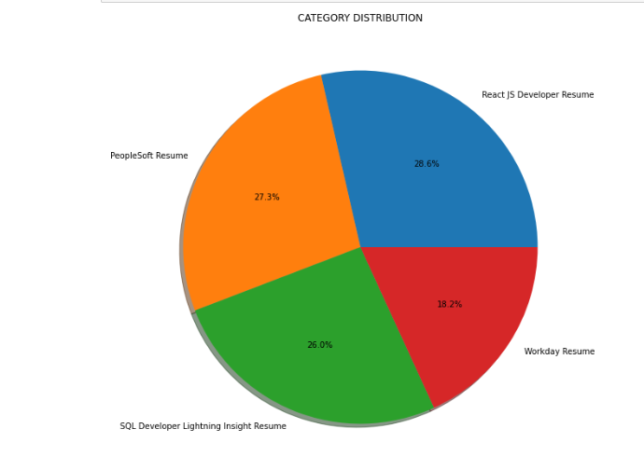
Visualization
Visualization of various categories

Slide 13
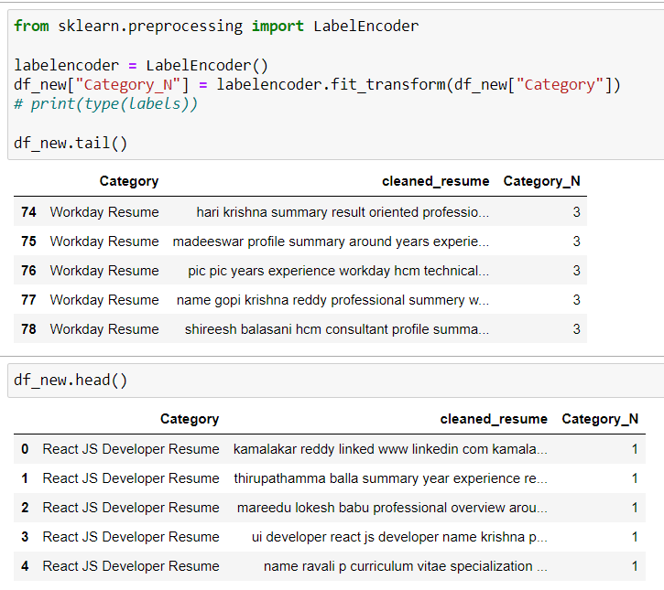
Label Encoder

Slide 14
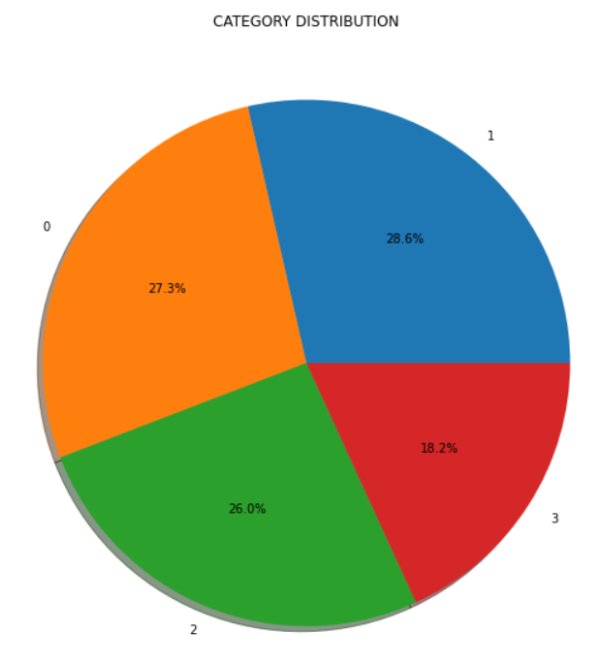
Label Encoder
Visualization of various categories after transforming
Categorical feature of “Resume category” into numeric values using label encoder.

Slide 15
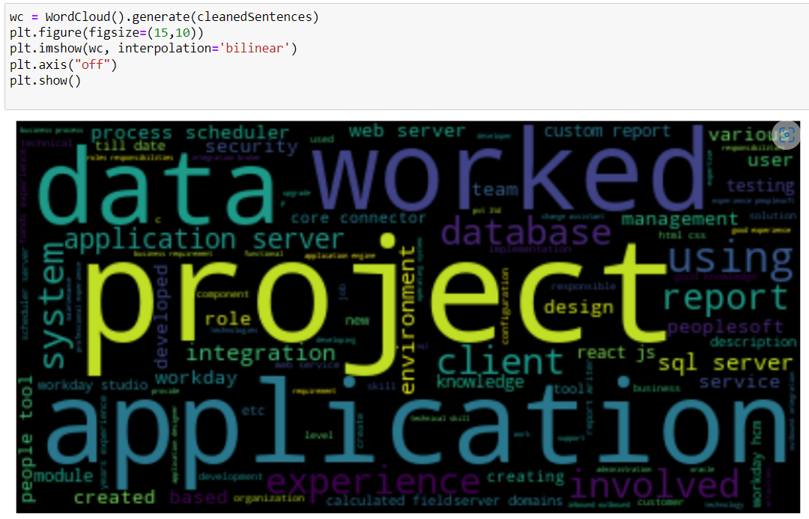
WORdcloud

Slide 16
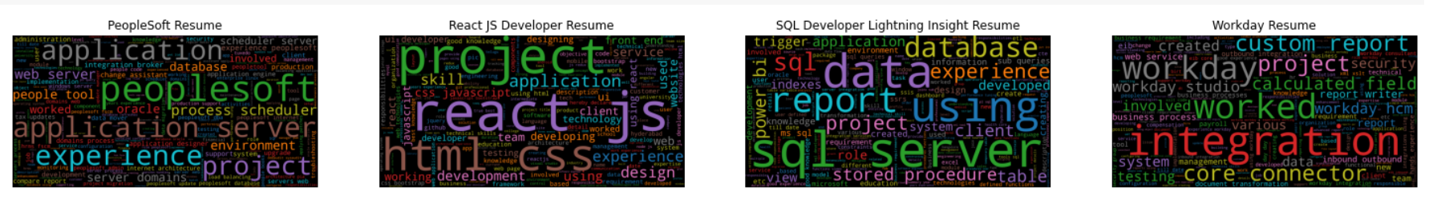
WOrdCloud Category wise

Slide 17
Model building
Algorithm Used | Accuracy Score
1)Logistic Regression | 0.93
2)KNN | 0.93
3)SVM | 0.93
4)Random Forest | 0.87
5)Decision Tree | 0.81
6) Multinomial NB Classifier | 0.87
7) AdaBoost Classifier | 0.62
8) GradientBoosting Classifier | 1.0
9) XtremeGradientBoosting Classifier | 1.0
10) LightGradientBoosting Classifier | 1.0

Slide 18
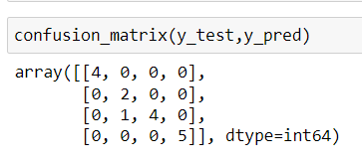
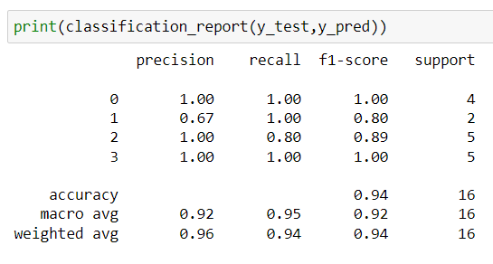
Using Logistic Regression

Slide 19
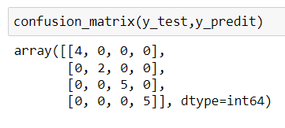
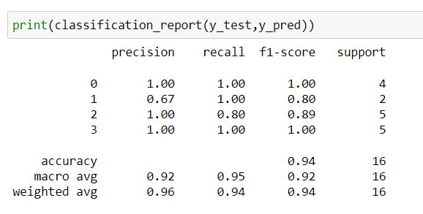
Using KNN

Slide 20
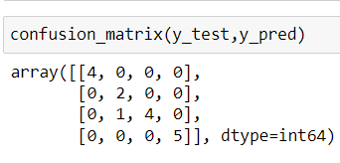
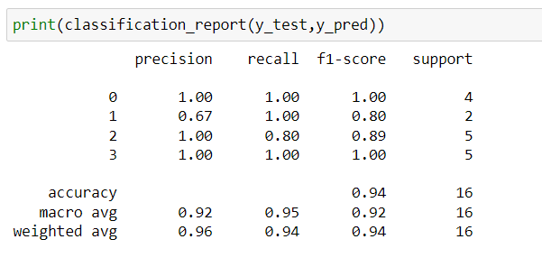
Using Svm

Slide 21
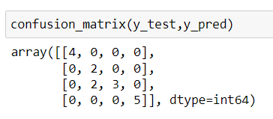
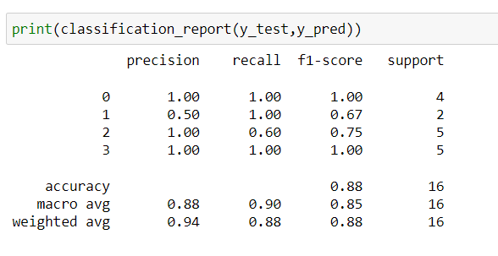
Using Random forest

Slide 22
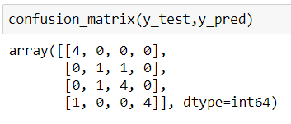
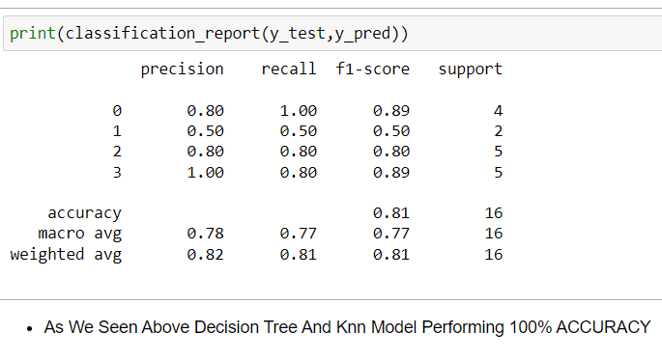
USING DECISION TREE

Slide 23
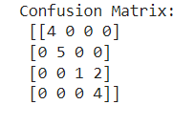
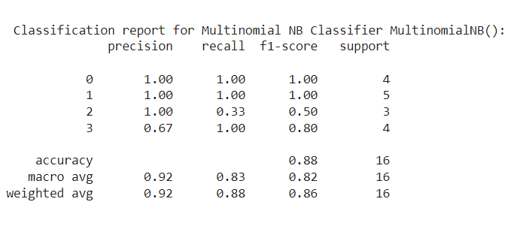
USING Multinomial NB Classifier

Slide 24
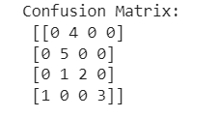
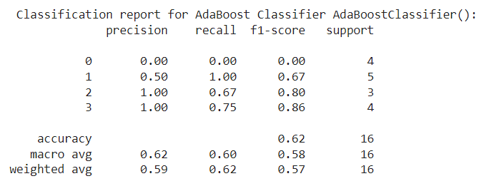
USING AdaBoost Classifier

Slide 25
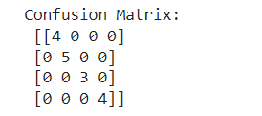
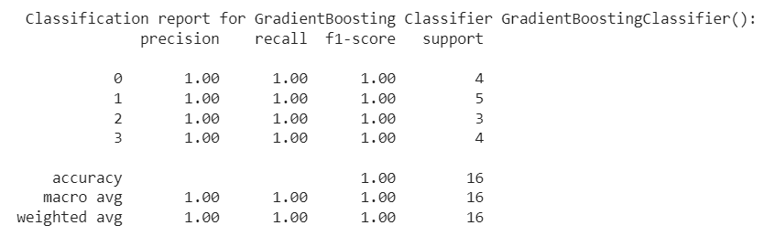
Using GradientBoosting Classifier

Slide 26
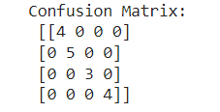
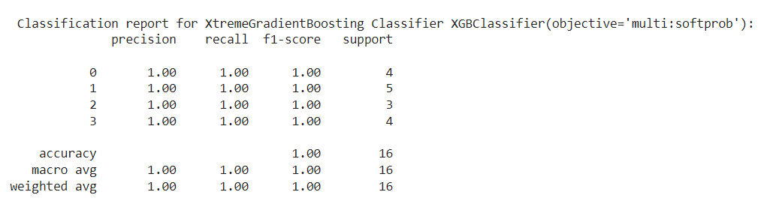
Using XtremeGradientBoosting Classifier

Slide 27
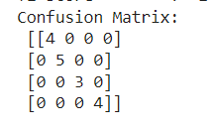
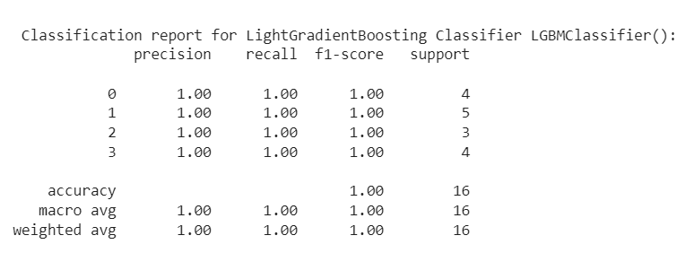
Using LightGradientBoosting Classifier

Slide 28
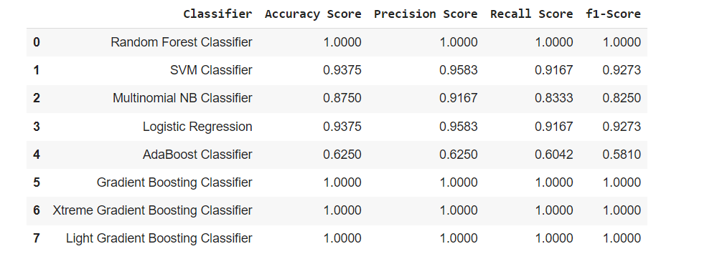
Summary of all the models performance

Slide 29
Deployment
For deployment we have finalized XtremeGradientBoosting model.
To retrieve the pickled data we used pickle.load() function. It is the process of converting python object into a byte stream to store it in a file to transport data .
We used nltk.download('wordnet’).
Wordnet is a lexical database for the English language used to find meaning of words, synonyms, antonmys etc.
By using nltk.download(‘stopwords’) we removed the stopwords from resume. Stop words are common words in human language that are frequent in text and don’t convey insights. e.g “the”, “or”, “to” etc..
Vectorized file we used for textpreprocessing.
In deployment part we have displayed the wordcloud of most commonly used words and frequency of common words along with the category of resume

Slide 30
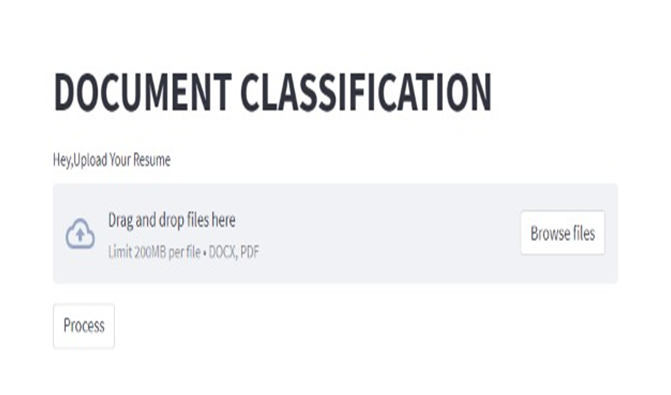
Project Deployment

Slide 31
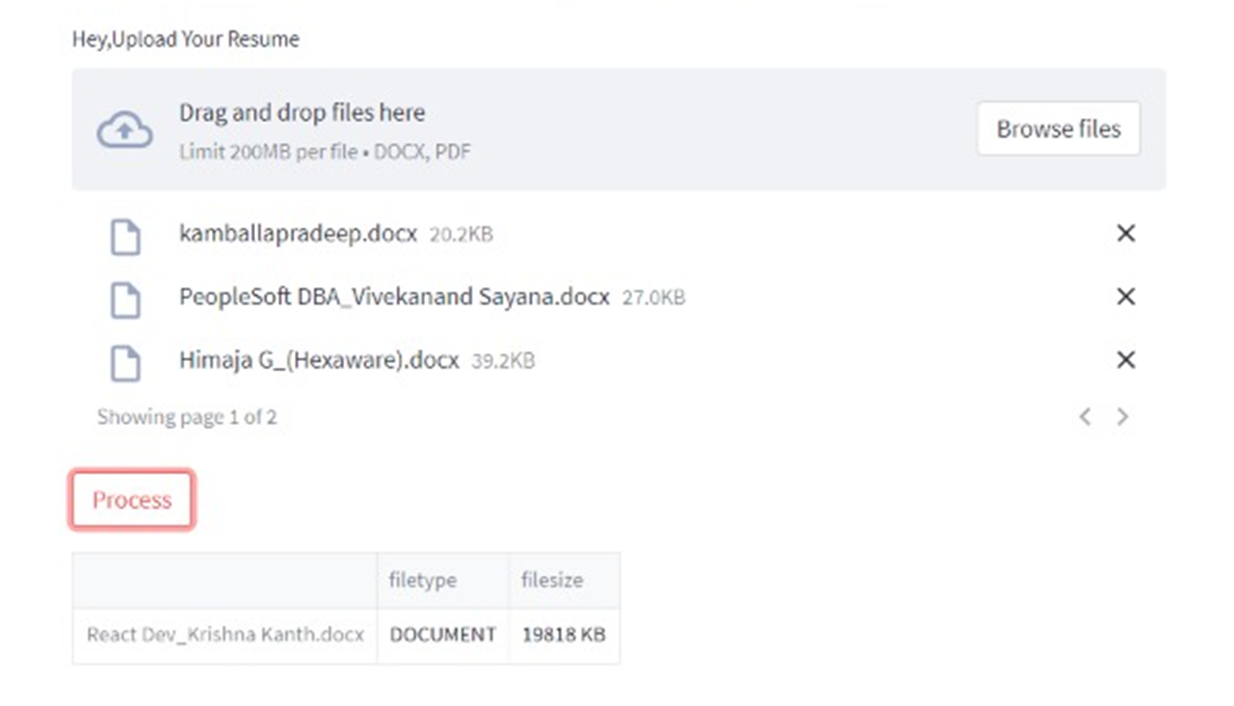
Document classification

Slide 32
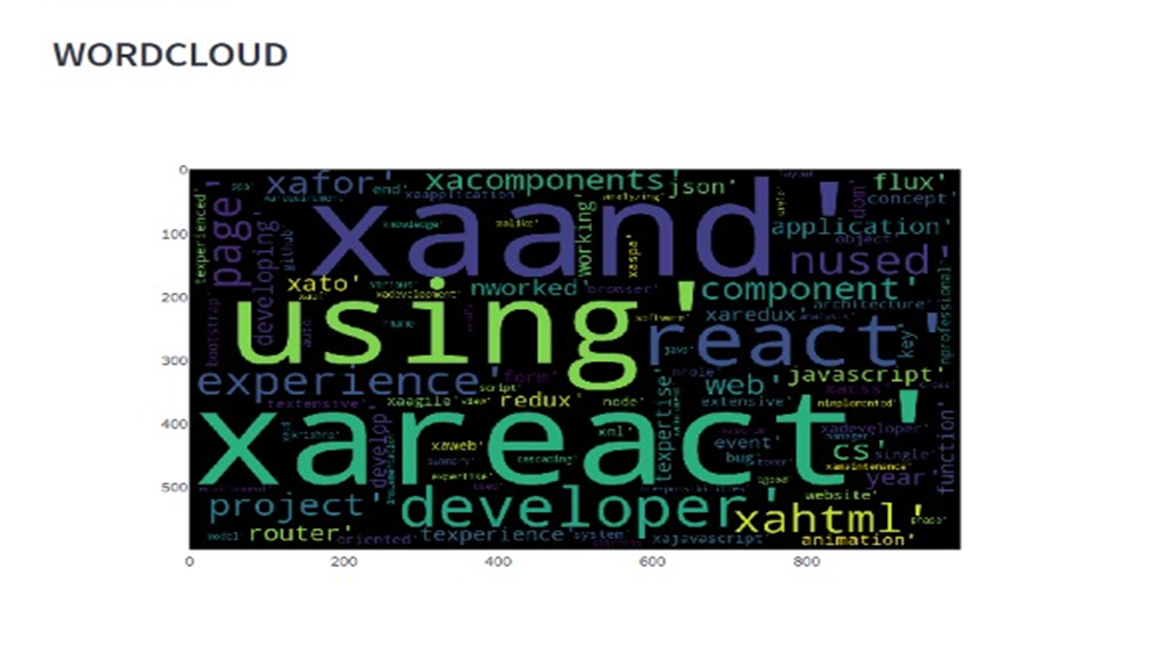
The Uploaded Resume is belongs to Reacts Resume

Slide 33
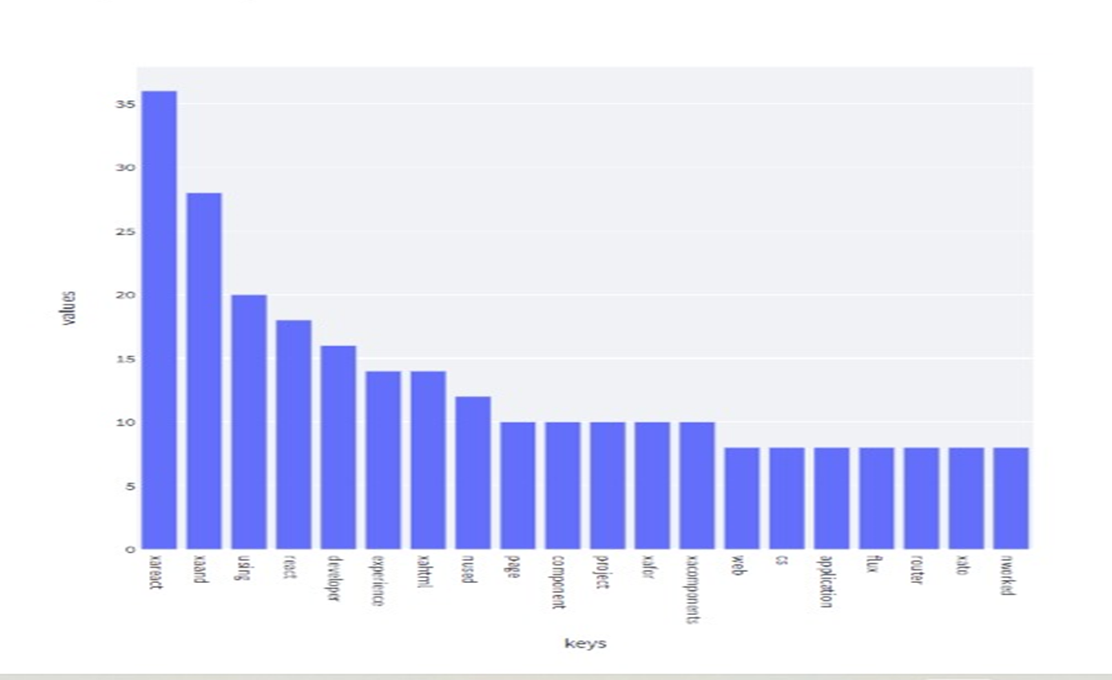
Frequency of 20 most common words

Slide 34
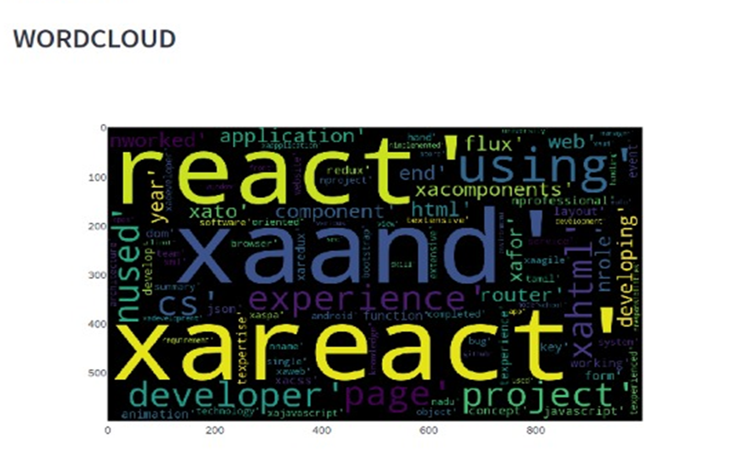
The Uploaded Resume is belongs to Reacts Resume

Slide 35
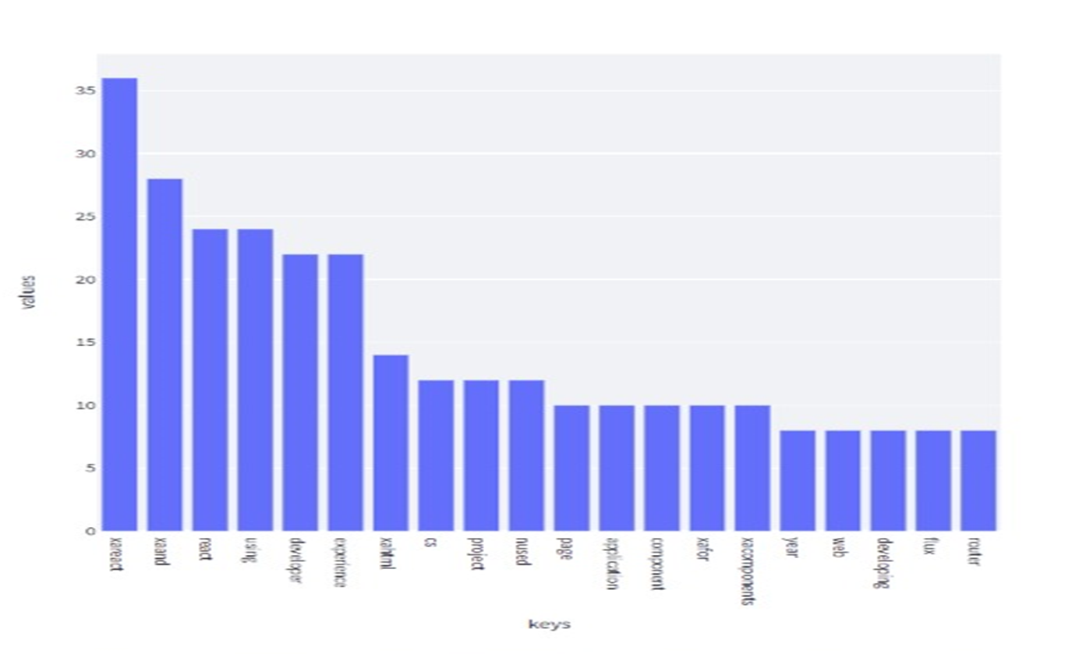
Frequency of 20 most common words

Slide 36
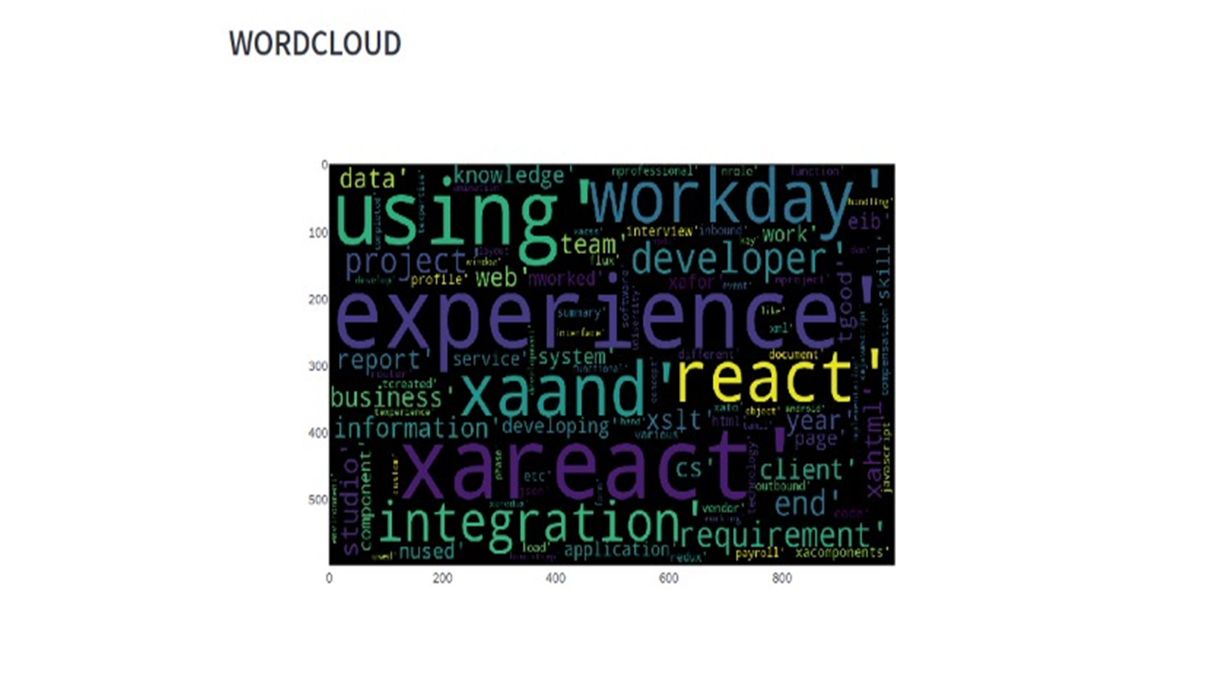
The Uploaded Resume is belongs to Workday Resume

Slide 37
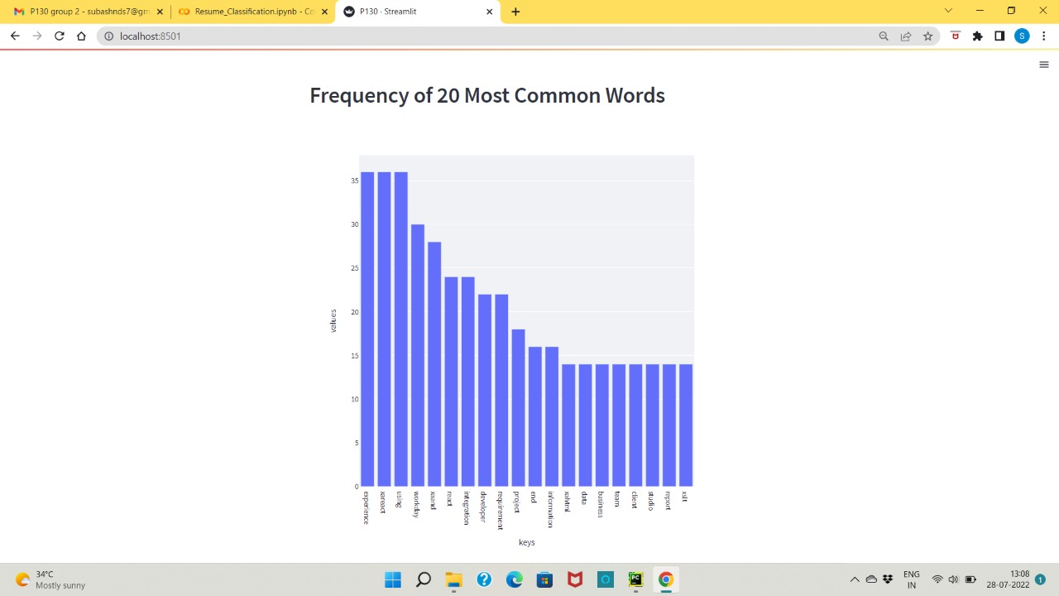
Frequency of 20 most common words

Slide 38
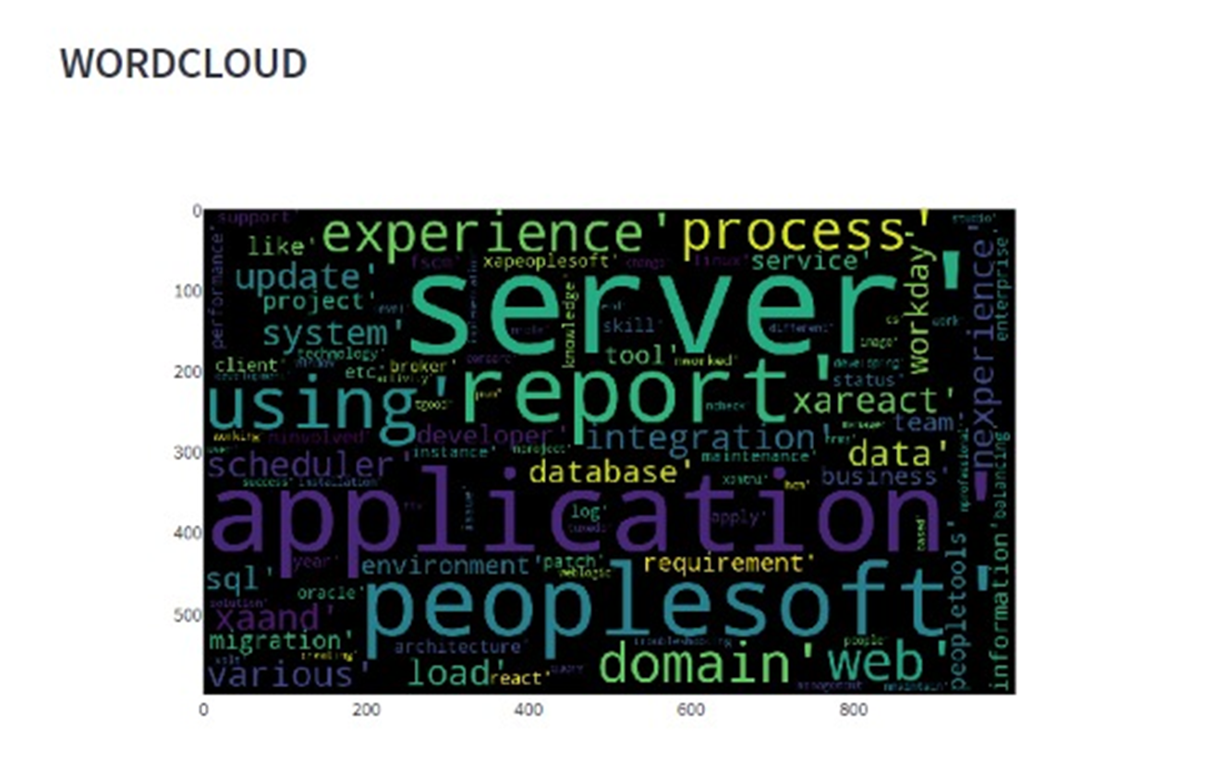
The Uploaded Resume is belongs to Workday Resume

Slide 39
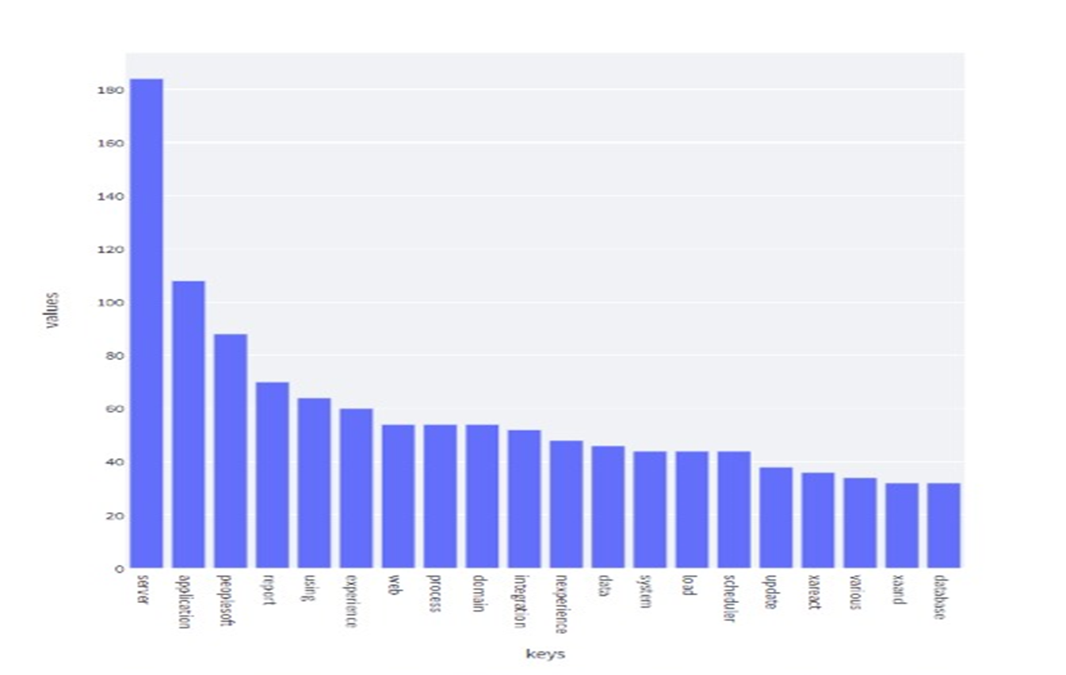
Frequency of 20 most common words

Slide 40

Thank you

